Slide 1
Wrapping it Up
What has been the key things we have been able to conclude?

Slide 2
The evolution of our Question
At First
We wanted to see if political contributions by industries to specific candidates had any bearing on election results
We also wanted to see if the election results had any specific impact on the market as a whole.
After Part 2
The idea morphed into looking at total campaign contributions and other aspects that led to candidates winning
This was mainly due to uncovering very little with respect to stock changes and voting shifts
An interesting paradox is the Financial Crisis

Slide 3
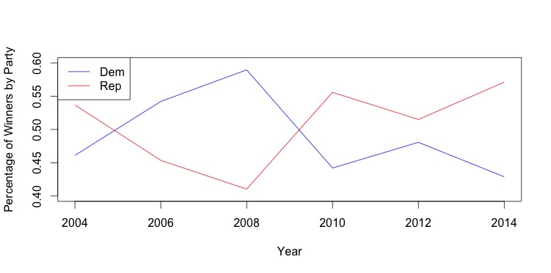
Election Results (2004 to 2014)

Slide 4
Some takeaways
Many of our conclusions supported already expected conclusions, but no major breakthroughs that we we were hopping for
Stocks aren’t significantly affected by election results
If you’re running for congress, make sure to be an incumbent

